Slide 1
GLeNN: Generative Augmented Large Language
Models for Binary Decompilation
Mack Bartsch
Bisesh Acharya
Craig Kimball
Justin Rockwell
Max Bedewi
4/24/2025

Slide 2
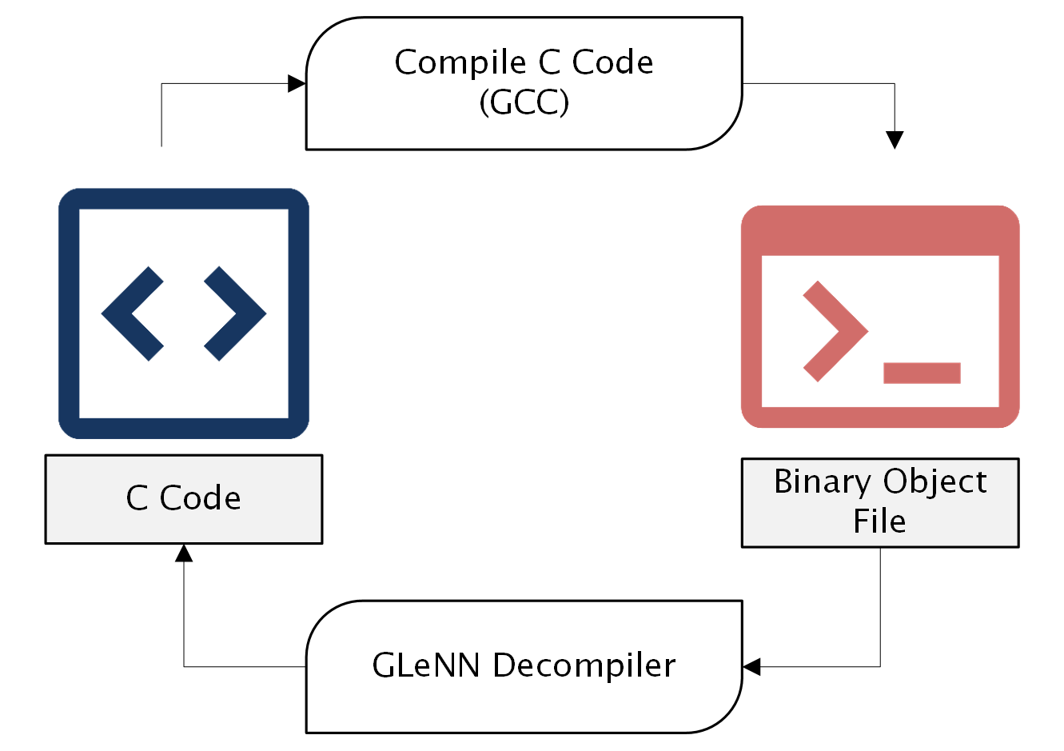
Introduction
Static reverse engineering is crucial for malware analysis, threat containment, and digital forensics
Manual techniques are precise but slow and rely on expert knowledge
Tools like Ghidra automate reverse engineering but struggle with optimized or obfuscated binaries
Our solution: GLeNN — combines retrieval with LLMs for smarter, safer decompilation
Notes:
"Reverse engineering plays a vital role in malware analysis, vulnerability research, and software validation. However, manual analysis is slow, labor-intensive, and not scalable. Tools like Ghidra and IDA Pro are powerful but can misinterpret complex or obfuscated code. Optimization by compilers can also significantly change code structure. So, we’re stuck between inaccurate automation and slow manual inspection. GLeNN is our attempt to bridge this gap."
Graph Language Enhanced Neural Network __________________
"Reverse engineering helps us understand code without executing it, which is critical for malware analysis. Manual methods are slow, and tools like Ghidra struggle with optimization and obfuscation. GLeNN aims to combine LLMs with reference-guided retrieval to improve both accuracy and speed."
__________________
Static reverse engineering is crucial for malware analysis, threat containment, and digital forensics
Manual techniques are precise but slow and heavily reliant on expert knowledge
Tools like Ghidra automate reverse engineering but struggle with optimized or obfuscated binaries
Our solution: GLeNN — combines retrieval with LLMs for smarter, safer decompilation
__________________
Static reverse engineering—the process of analyzing executable code without running it—plays a vital role in cybersecurity. It enables analysts to understand the functionality of potentially malicious software while avoiding the risks associated with dynamic execution. This analysis supports threat containment, post-incident recovery, and long-term defensive improvements. By uncovering what actions a program takes, how it manipulates memory, and what systems it impacts, reverse engineering offers critical insights for cyber defense teams.
Traditionally, reverse engineering is conducted through one of two approaches: manual analysis or automated tooling. Manual reverse engineering is often the most accurate, allowing a skilled analyst to deeply inspect a binary's behavior. However, this process is labor-intensive and requires substantial expertise in low-level programming and binary structures. In contrast, automated tools like the NSA’s Ghidra or Hex-Rays' IDA Pro significantly speed up analysis by transforming binary code into high-level pseudocode. Yet these tools frequently produce inaccurate output when faced with highly optimized or obfuscated code, often requiring human intervention to clean up logic errors or misunderstood control structures.
A significant challenge in automated reverse engineering is the loss of semantic and structural information during compilation. Even simple optimizations can drastically alter code layout, making it difficult to recover original logic. These problems are exacerbated when facing malware designed specifically to hinder analysis. Recent advances in Large Language Models (LLMs) have introduced new possibilities by framing reverse engineering as a language translation task—from low-level machine code to high-level C-like syntax. However, models like LLM4Decompile still suffer from hallucinations and limited understanding of program context. These shortcomings arise from the sheer complexity of code semantics and the unpredictable nature of machine-compiled logic.
To address these challenges, our research explores the integration of Retrieval-Augmented Generation (RAG) into the reverse engineering pipeline. RAG enhances LLM performance by incorporating semantically similar reference code during inference, providing additional context that helps the model make informed predictions. This paper presents GleNN, a system that builds a graph-based database of control-flow structures and uses them to retrieve relevant C code that informs the LLM’s decompilation output. Our aim is to evaluate whether this integration improves the syntactic correctness, semantic coherence, and executable accuracy of the generated C code when compared to existing tools.
The research question of this project we hope to answer is can the integration of a retrieval-augmented generation (RAG) pipeline improve the precision and completeness of LLM-based static reverse engineering when applied to obfuscated or optimized binaries?

Slide 3

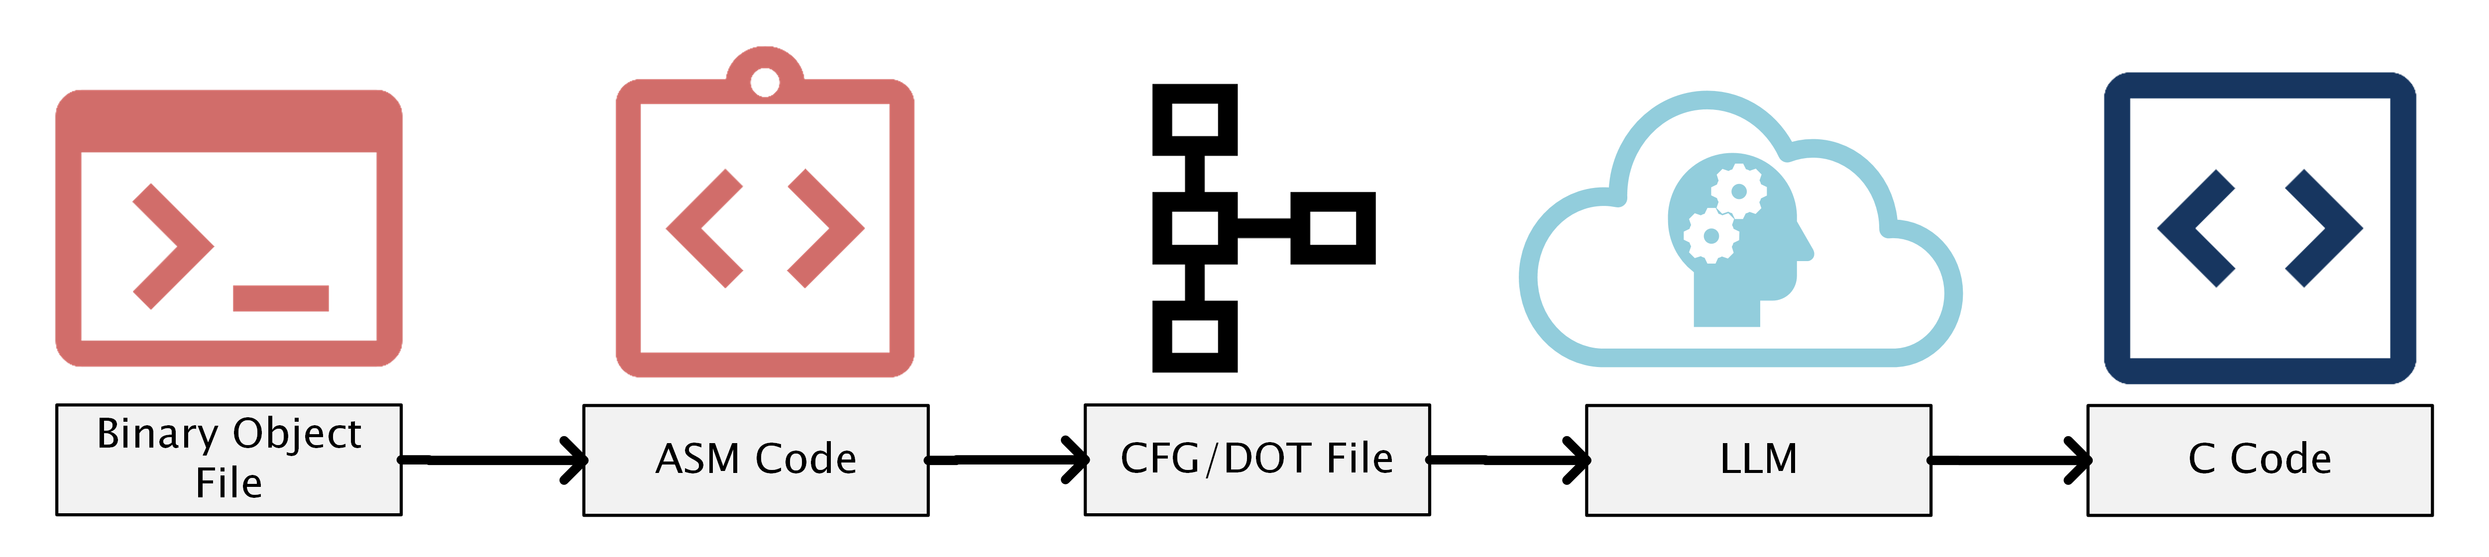
Research Question
Can the integration of a retrieval-augmented generation (RAG) pipeline improve the precision and completeness of LLM-based static reverse engineering when applied to compiled binaries?”
Notes:
______________
Static reverse engineering—the process of analyzing executable code without running it—plays a vital role in cybersecurity. It enables analysts to understand the functionality of potentially malicious software while avoiding the risks associated with dynamic execution. This analysis supports threat containment, post-incident recovery, and long-term defensive improvements. By uncovering what actions a program takes, how it manipulates memory, and what systems it impacts, reverse engineering offers critical insights for cyber defense teams.
Traditionally, reverse engineering is conducted through one of two approaches: manual analysis or automated tooling. Manual reverse engineering is often the most accurate, allowing a skilled analyst to deeply inspect a binary's behavior. However, this process is labor-intensive and requires substantial expertise in low-level programming and binary structures. In contrast, automated tools like the NSA’s Ghidra or Hex-Rays' IDA Pro significantly speed up analysis by transforming binary code into high-level pseudocode. Yet these tools frequently produce inaccurate output when faced with highly optimized or obfuscated code, often requiring human intervention to clean up logic errors or misunderstood control structures.
A significant challenge in automated reverse engineering is the loss of semantic and structural information during compilation. Even simple optimizations can drastically alter code layout, making it difficult to recover original logic. These problems are exacerbated when facing malware designed specifically to hinder analysis. Recent advances in Large Language Models (LLMs) have introduced new possibilities by framing reverse engineering as a language translation task—from low-level machine code to high-level C-like syntax. However, models like LLM4Decompile still suffer from hallucinations and limited understanding of program context. These shortcomings arise from the sheer complexity of code semantics and the unpredictable nature of machine-compiled logic.
To address these challenges, our research explores the integration of Retrieval-Augmented Generation (RAG) into the reverse engineering pipeline. RAG enhances LLM performance by incorporating semantically similar reference code during inference, providing additional context that helps the model make informed predictions. This paper presents GleNN, a system that builds a graph-based database of control-flow structures and uses them to retrieve relevant C code that informs the LLM’s decompilation output. Our aim is to evaluate whether this integration improves the syntactic correctness, semantic coherence, and executable accuracy of the generated C code when compared to existing tools.
The research question of this project we hope to answer is can the integration of a retrieval-augmented generation (RAG) pipeline improve the precision and completeness of LLM-based static reverse engineering when applied to obfuscated or optimized binaries?

Slide 4

Achievements
35 pp increase over LLM4Decompile
Two-pass Neo4j retrieval (vector + GED) → cuts down on LLM hallucinations
Proved that RAG enabled LLMs greatly enhance static decompilation precision & completeness
Fully open source and available on GitHub

Slide 5
Key Challenges
LLMs hallucinate or oversimplify logic
Context-free predictions often miss intent
Obfuscation complicates analysis
Existing tools still require manual cleanup
RAG provides structural grounding, reducing hallucinations and improving accuracy.
Notes:
"LLMs have shown great potential in code generation and translation, but when applied to decompilation, they often hallucinate logic—adding or omitting key behaviors. These hallucinations can lead to incorrect assumptions about a program’s functionality, which is dangerous in a security context. Worse, real-world binaries are often obfuscated to hide intent. Without structural guidance, even the best models struggle. So we asked: what if we could show the model examples of code that 'looks like' the input binary?"
______________
While recent advances in Large Language Models (LLMs) have made it possible to decompile binaries by treating them as a language translation problem, there are still several important challenges that limit their effectiveness. This work is motivated by the following key observations:
\begin{itemize}
\item \textbf{LLMs hallucinate code logic.} Models like LLM4Decompile often generate syntactically valid C code that deviates from the true behavior of the original binary. These hallucinations can include missing conditions, fabricated control flow, or overly generalized logic, making the output unsafe or misleading for analysts.
\item \textbf{Context-free predictions are error-prone.} LLMs typically decompile functions in isolation, without understanding the broader context of how similar functions are commonly structured. Without this grounding, models lack the constraints needed to produce accurate or executable results—especially in edge cases or optimized binaries.
\item \textbf{Obfuscation and compiler optimizations break assumptions.} Compilers regularly restructure code in ways that obscure the original logic. Malware authors take this further by intentionally obfuscating control flow. In both cases, recovering the intent of a function requires more than pattern-matching—it requires structural understanding.
\item \textbf{Existing tools are either brittle or overly manual.} Tools like Ghidra and IDA Pro are powerful, but their decompiled outputs still often require manual cleanup or expert interpretation. LLMs offer promise, but their outputs need guidance to match the precision and reliability required in real-world reverse engineering.
\item \textbf{Retrieval-Augmented Generation (RAG) offers a path forward.} By retrieving relevant and structurally similar examples to use as context during generation, we can ground LLM predictions in real code. This can reduce hallucinations, improve structure fidelity, and help models better align with the semantics of the binary being analyzed.
\end{itemize}
In this context, our work asks: \emph{Can the integration of a retrieval-augmented generation (RAG) pipeline improve the precision and completeness of LLM-based static reverse engineering when applied to obfuscated or optimized binaries?} GleNN is our answer to that question.

Slide 6
Our Approach
Developed GLeNN: first system combining graph-edit similarity with LLM-based decompilation.
Introduced a two-pass retrieval pipeline using vector and GED-based filtering.
Constructed a graph database (Neo4j) of 25,000+ C function CFGs.
35 pp increase over LLM4Decompile
Notes:
"Our key innovations are: First, the application of graph-based retrieval to guide LLM decompilation. Second, a curated Neo4j database with thousands of compiled C functions, each converted into a control-flow graph. Third, a two-pass search process that balances speed and precision. And finally, our results: GLeNN achieved nearly perfect execution rates on test binaries."
______________
This work presents \textbf{GleNN: Generative Augmented Large Language
Models for Binary Decompilation}, a reverse engineering tool that integrates graph-based code retrieval with Retrieval-Augmented Generation (RAG) to improve the quality and accuracy of LLM-assisted decompilation. GleNN bridges the gap between control-flow structure analysis and semantic code prediction by leveraging a graph similarity engine to retrieve functionally similar reference code, which is then injected into the prompt for a large language model.
To the best of our knowledge, \emph{this work is the first to combine graph edit distance (GED)-based control-flow similarity with LLM-based decompilation in a RAG framework}. It introduces a hybrid retrieval mechanism and a modular design that demonstrates improved decompilation outcomes across metrics of compile-ability and executability.
Our key contributions are summarized as follows:
\begin{itemize}
\item We introduce \textbf{GleNN}, a novel reverse engineering system that uses graph-based structural retrieval to supplement an LLM with relevant C code snippets for improved decompilation. GleNN enhances context and reduces hallucinated logic by incorporating known examples that reflect the target function’s control flow.
\item We design and implement a two-pass retrieval strategy (Section~\ref{sec:methodology}), combining Euclidean distance-based filtering of structural vector embeddings with a refined graph edit distance (GED) similarity search. This allows efficient and accurate retrieval across a large Neo4j graph database containing over 25,000 known function CFGs.
\item We evaluate GleNN against LLM4Decompile and a DeepSeek baseline on a shared dataset (Section~\ref{sec:results}). GleNN achieved \textbf{99.41\%} re-executability and a \textbf{12.44\%} improvement over the baseline, demonstrating the impact of structurally grounded context on output fidelity.
\item We provide a case study (Section~\ref{sec:discussions}) using the \texttt{count\_alpha\_digit} function from ExeBench to illustrate how structural similarity retrieval improves code generation quality. We analyze the baseline vs. GleNN outputs and show that the latter matches both control structure and semantic precision of the original source code.
\end{itemize}
The remainder of the paper is structured as follows: Section II surveys related work in static reverse engineering and RAG. Section III and IV describe our preliminary experiments. Section V outlines the final GleNN architecture and its components. Section VI presents the evaluation results. Section VII discusses real-world implications and concludes the work.

Slide 7


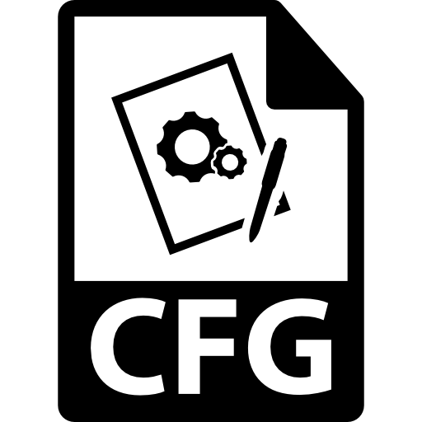
Related Work
Static Tools: Ghidra, IDA Pro: Fast but semantically weak
LLMs:
LLM4Decompile:High-level translation, suffers hallucination
DeepSeek R1: State of the Art model available to the public
Control Flow Graph (CFG): Capture logic structure for better retrieval guidance
Notes:
"Tools like Ghidra and IDA Pro are essential in reverse engineering. But they were never built for deep semantic understanding. They rely on heuristics, pattern-matching, and fixed rules. Once you start dealing with hand-crafted malware or compiler-optimized code, their output can become unreliable, often missing key behaviors or misrepresenting logic.”
"The idea of using LLMs for reverse engineering is new but exciting. If you think about it, decompilation is like translation—from machine code to human-readable C. However, LLMs alone often make things up. RAG helps solve that. By retrieving similar known examples and feeding them as context, we help the model stay grounded in reality."
"A CFG breaks down a function into basic blocks and the paths between them. This is crucial because even if the code changes, its structure often remains similar. By comparing CFGs, we can detect functions that 'behave' similarly even if the actual code is different."
______________
Traditional reverse engineering tools such as NSA’s Ghidra and Hex-Rays' IDA Pro are widely used to deconstruct binary programs into human-readable forms. These tools rely on a combination of pattern recognition, rule-based heuristics, and decompilation strategies to produce pseudo-C code from compiled binaries. While effective in streamlining the reverse engineering workflow, they often fall short in recovering semantic meaning, especially when analyzing optimized or obfuscated code. In such cases, human analysts must manually refine the generated output, resulting in significant time and expertise overhead.
\subsection{Large Language Models and RAG}
Large Language Models (LLMs) have shown promise in treating code translation tasks—such as decompilation—as a form of language translation. Projects like LLM4Decompile have demonstrated that transformer-based architectures can learn to map assembly code to C code. However, these models are susceptible to hallucinations, syntactic inconsistencies, and logical inaccuracies, particularly when lacking sufficient context.
To improve this, Retrieval-Augmented Generation (RAG) strategies have been explored in other natural language domains. RAG provides an LLM with supplementary reference material during inference, helping ground its predictions in actual examples. By adapting RAG to reverse engineering, it becomes possible to offer the model context that reflects real code behavior, potentially reducing hallucinations and improving semantic fidelity.
\subsection{Control Flow Graphs and Code Retrieval}
A control-flow graph (CFG) is a visual and structural representation of a program’s logic and branching behavior. CFGs help analysts and models alike understand how instructions flow from one segment to another, including conditions, loops, and jumps. GleNN leverages these CFGs as queryable graph data, using Neo4j as a storage and retrieval layer. Each function’s structure—nodes, edges, loops, decisions—is embedded and indexed, enabling efficient similarity-based retrieval.
By comparing the CFG of an unknown function to a database of known examples, GleNN identifies similar control structures and retrieves their corresponding C implementations. These C snippets serve as reference points for RAG-enhanced inference, helping guide the LLM toward more accurate code reconstruction. As shown in Fig.~\ref{fig:cfg_example}, even when two functions perform different tasks, similar control structures such as nested loops and conditionals can be identified and used to retrieve contextually relevant code examples.

Slide 8
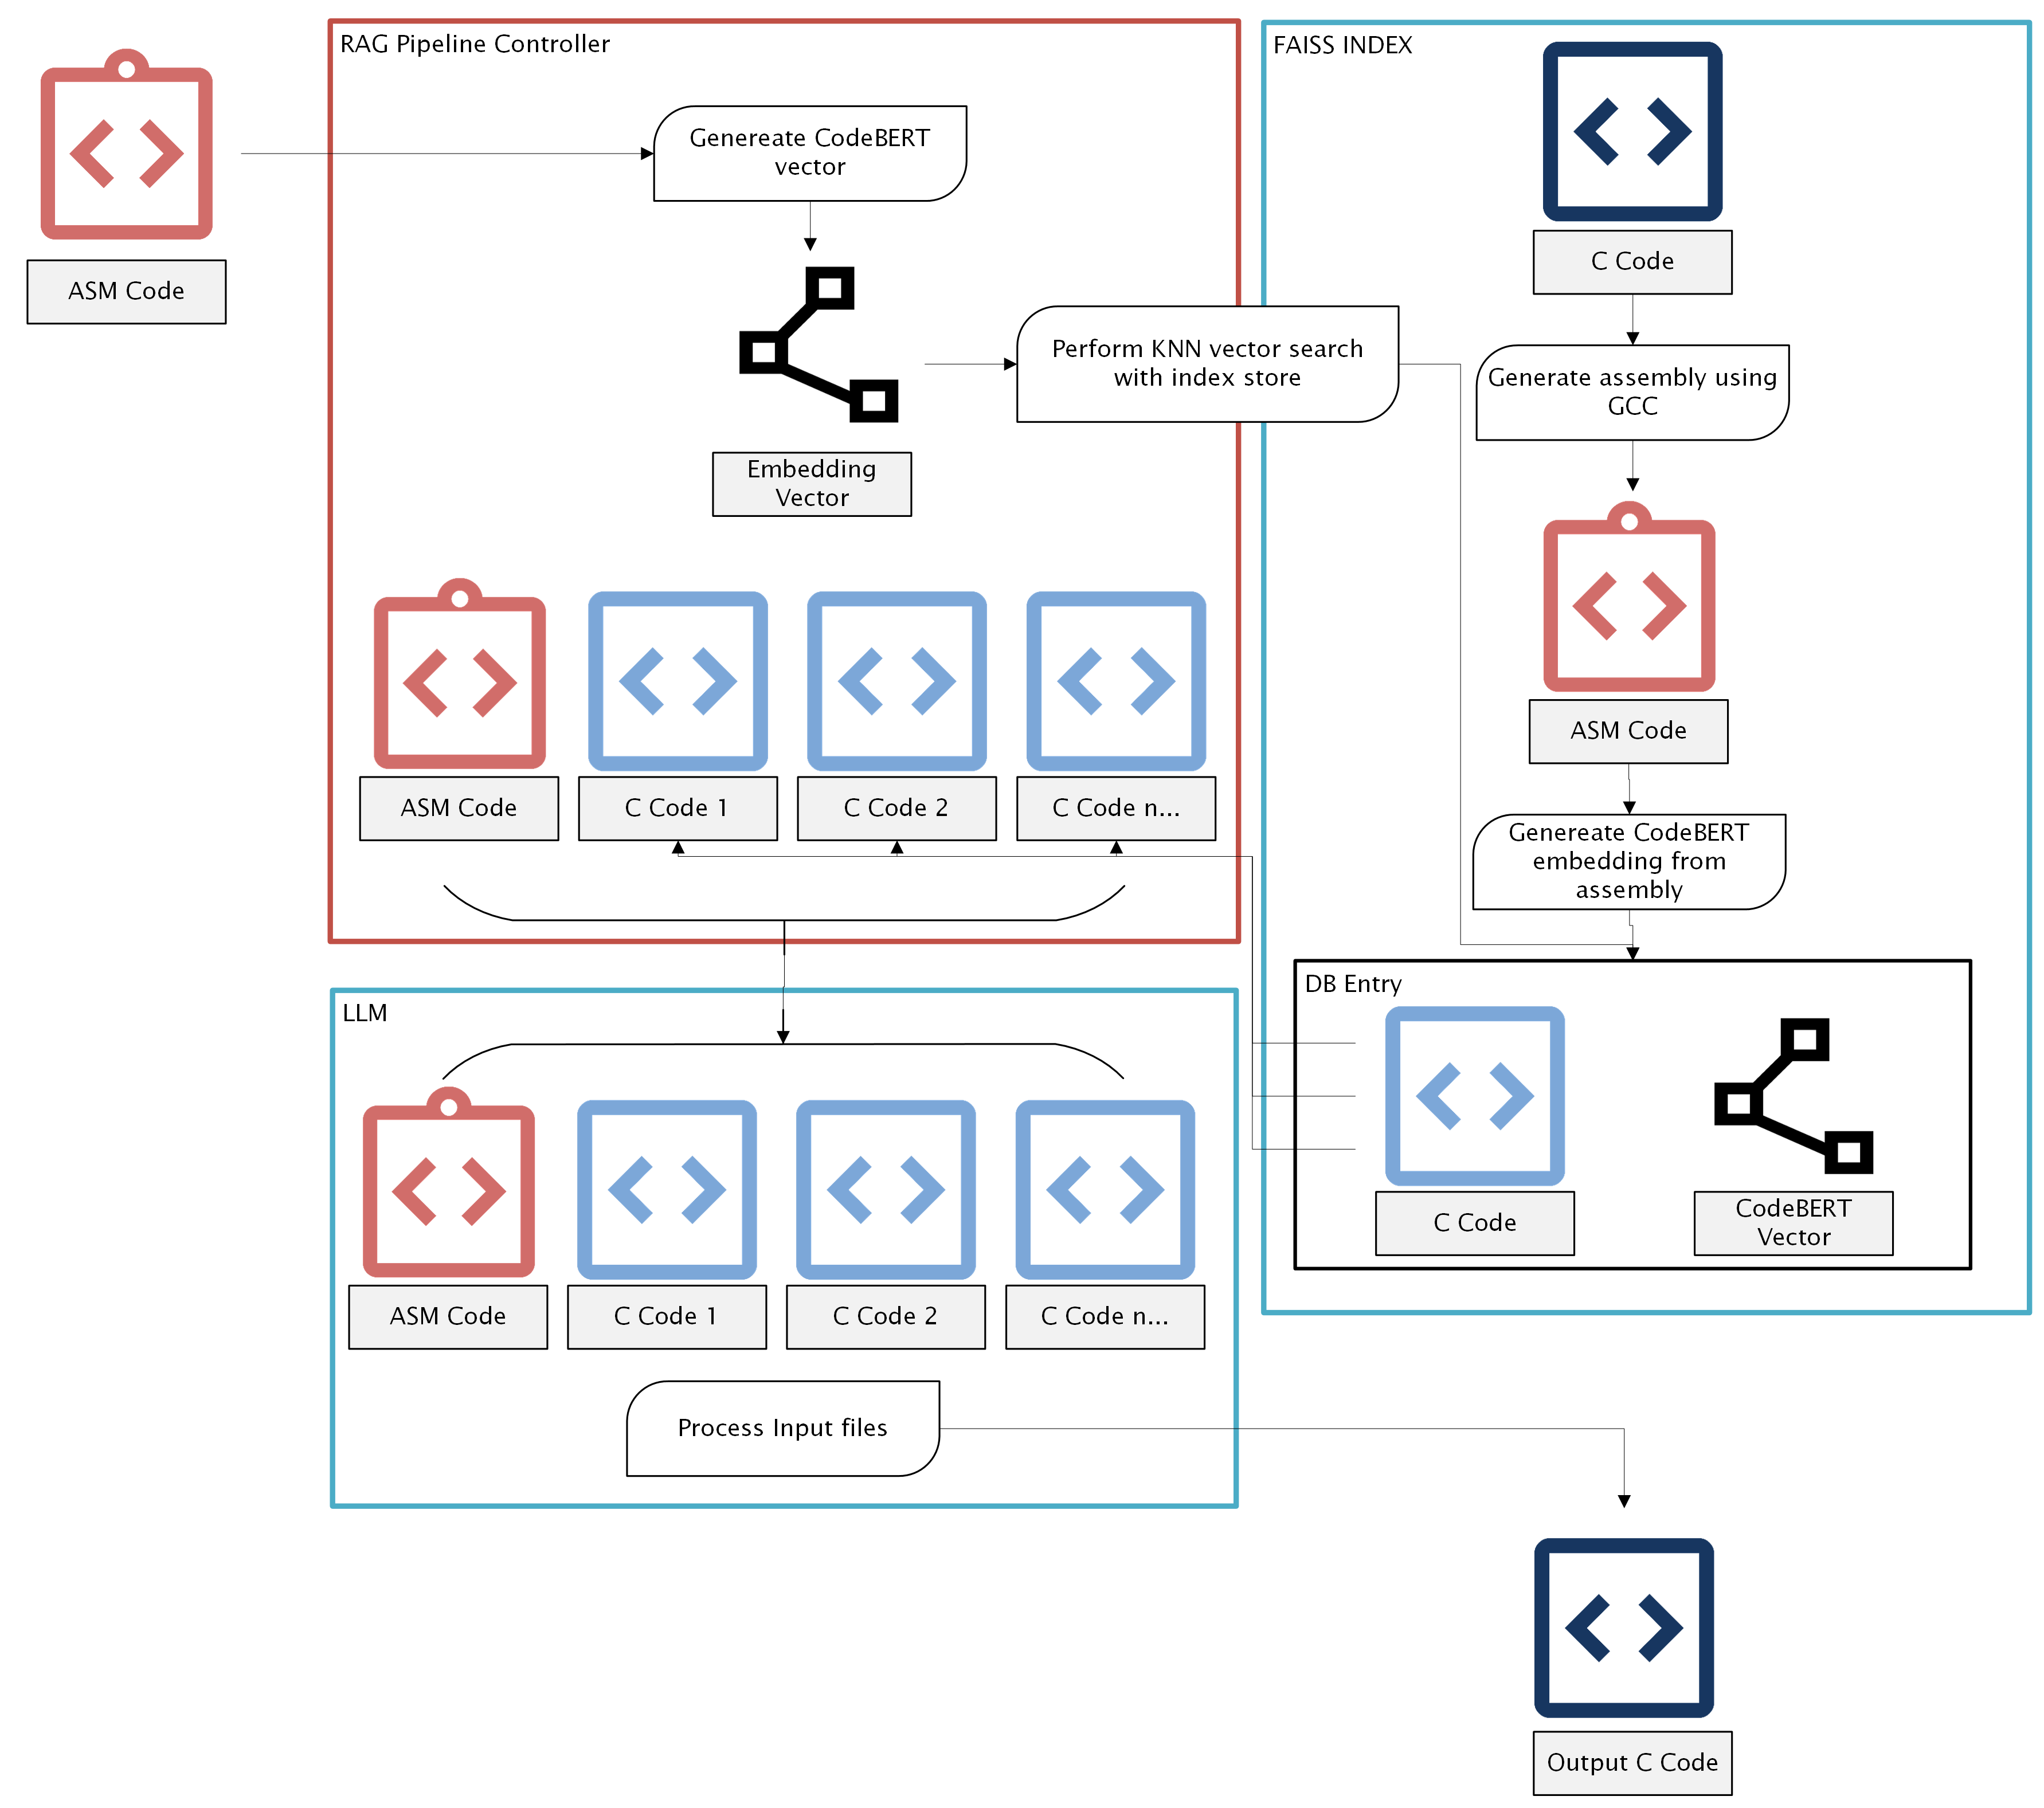
Experiment 1 – Vector Embeddings
Objective:
Apply RAG layer to LLM
Prove that context rich prompts assists in decompilation
Implementation:
Embedding model: CodeBERT.
Vector index: FAISS, allowed KNN-based retrieval.
Notes:
"In our first experiment, we used CodeBERT to embed functions into vector space and did similarity search.
This proved that context helps.
But embeddings alone couldn’t capture logic flow or branching structures. We needed more than just lexical similarity."
______________
In our first experiment, we conducted a preliminary investigation utilizing a vector-based approach before establishing our Neo4j graph database infrastructure. The primary goal was to assess whether integrating contextual information into a Large Language Model (LLM) through Retrieval-Augmented Generation (RAG) techniques could enhance decompilation outcomes. To achieve this, basic numeric vector embeddings were created usign the CodeBERT embedding model from initial code snippets of the ExeBench dataset. These embeddings were mathmatical representations of the semantic content and characteristics of the code snippets. These embeddings were stored using a Facebook AI Similarity Search (FAISS) index that allowed us to perform a K-Nearest Neighbords (KNN) search on the dataset. This method enabled a rapid and practical assessment of the potential advantages provided by contextual embedding in improving the output accuracy of the LLM model.
\subsection{Observations}
Our initial observations from this vector-based experiment were encouraging, demonstrating that even elementary contextual embeddings could significantly enhance the accuracy and relevance of outputs generated by the LLM. Qualitative evaluations indicated improvements in decompilation performance, confirming that providing contextual embeddings had tangible benefits. Nevertheless, given the simplified nature of the vector construction, we also observed notable limitations in capturing the semantic details and details necessary for highly accurate retrieval. These limitations were particularly present in scenarios involving complex function logic or less frequently occurring code patterns, leading to some inaccuracies and incomplete contextual matches. This method would often produce results more closely related to the search provided C code rather than de-compiling the input function.
This preliminary vectorized pipeline experiment validated the foundational hypothesis that providing contextual embeddings improves LLM decompilation performance. The primary takeaway was the clear validation of the efficacy of RAG methodologies even with minimal structural context. Despite these successes, we recognized substantial room for improvement, specifically in enhancing the accuracy and semantic richness of embeddings. This insight highlighted the need for a more advanced embedding strategy, potentially incorporating deeper semantic representations or hybrid methodologies combining embeddings with structural graph-based approaches, to address the identified limitations and further enhance performance.

Slide 9
Experiment 1 – Vector Embeddings
Observations:
Validated RAG improves output relevance but lacked deep structural understanding.
Similarity on embedding alone missed important control structures.
Introduced a new source of error, too much influence from context code

Slide 10
Experiment 2 – CFG Comparison
Objective:
Apply CFG comparison to RAG
Implementation:
Generated CFGs from source via GCC
Compared structures with string vectors
Notes:
"Next, we generated CFGs from source and compared their structures. But when we let the LLM generate C code from assembly and then tried to generate a CFG from that output, the hallucinated logic wrecked everything. We learned a crucial lesson: always extract CFGs directly from binaries, not model-generated guesses."
______________
In our second experiment, we aimed to develop and evaluate a reliable method for structurally comparing distinct functions using Control-Flow Graphs (CFGs). Recognizing CFGs as highly structured representations of program logic, we first generated CFGs directly from verified C source files utilizing GCC. Given the complexity of generating CFGs directly from object files at this stage, we established an alternative preliminary proof-of-concept approach. Specifically, we converted a known .c source file into assembly language (.s format) using GCC. Subsequently, we employed our LLM model to decompile this assembly code back into a new .c file, which served as the basis for CFG generation. This indirect approach provided an initial mechanism to assess the structural comparisons. Initially, our CFG comparisons utilized a straightforward vectorized string comparison approach, leveraging embeddings from CodeBERT to measure similarity.
\subsection{Observations}
The CFG-based experimental methodology allowed us to successfully perform structural comparisons between functions, confirming the viability of using CFGs for similarity assessments. However, significant challenges emerged from the initial step involving LLM-based decompilation from assembly back to C, where substantial inaccuracies and model hallucinations were introduced. These errors critically compromised the overall accuracy of the generated CFGs from the very beginning. Furthermore, we observed that our simplistic vectorized string comparison method, while efficient, was notably inadequate in accurately representing true structural and semantic similarities between functions. The database demonstrated good retrieval accuracy for known and previously indexed code snippets, but its performance markedly deteriorated when encountering functions or patterns not explicitly represented within our reference dataset.
This experiment emphasized both the potential utility and inherent limitations of CFG-based approaches, especially when CFG generation methods are indirect and reliant on intermediate, error-prone steps such as LLM-based decompilation. We clearly identified the critical need to avoid or minimize reliance on indirect generation methods that inherently introduce significant inaccuracies. Additionally, the inadequacy of basic string-based vector comparisons highlighted the necessity for more advanced structural similarity measures to accurately capture the complexities inherent in code structure. These findings underscored the importance of developing direct, accurate, and reliable methods for CFG generation and emphasized the value of robust structural comparison metrics.

Slide 11
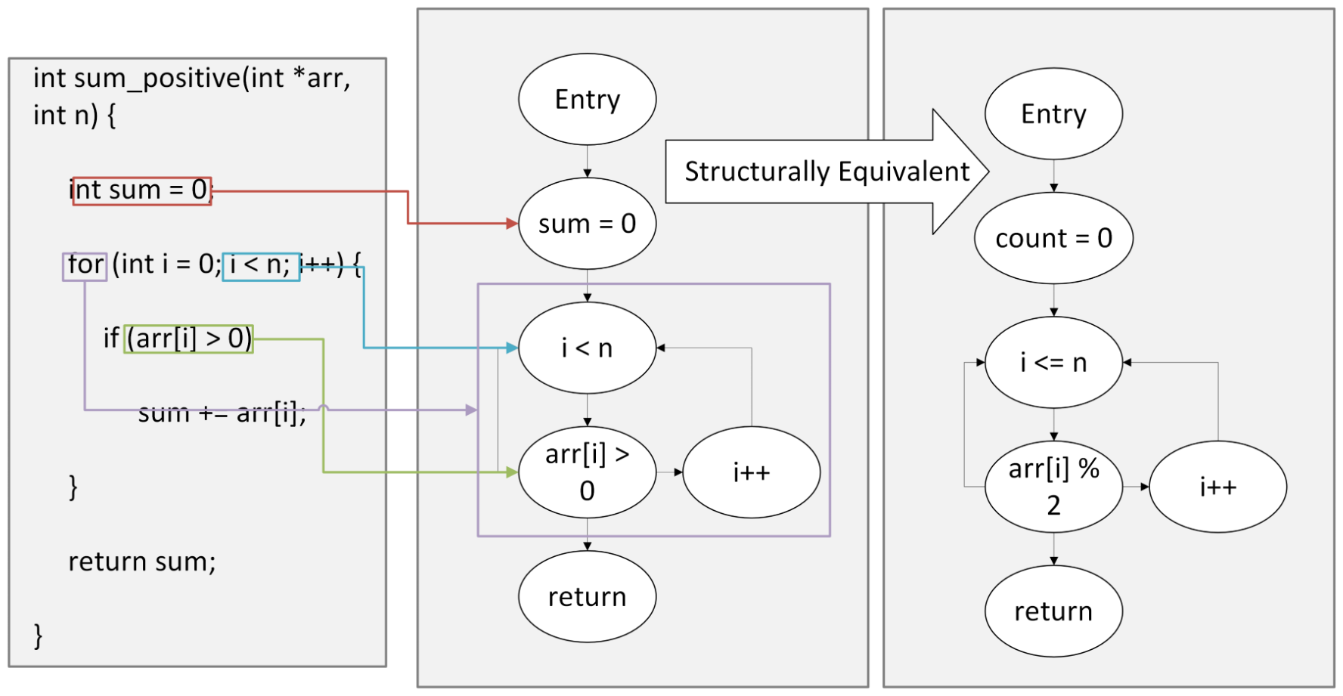
Experiment 2 – CFG Comparison
Observations
Process required CFGs to be created from C code which required doing two passes to the model
Would introduce error in the first pass of model generation
Provided key insight into the capabilities of CFGs

Slide 12
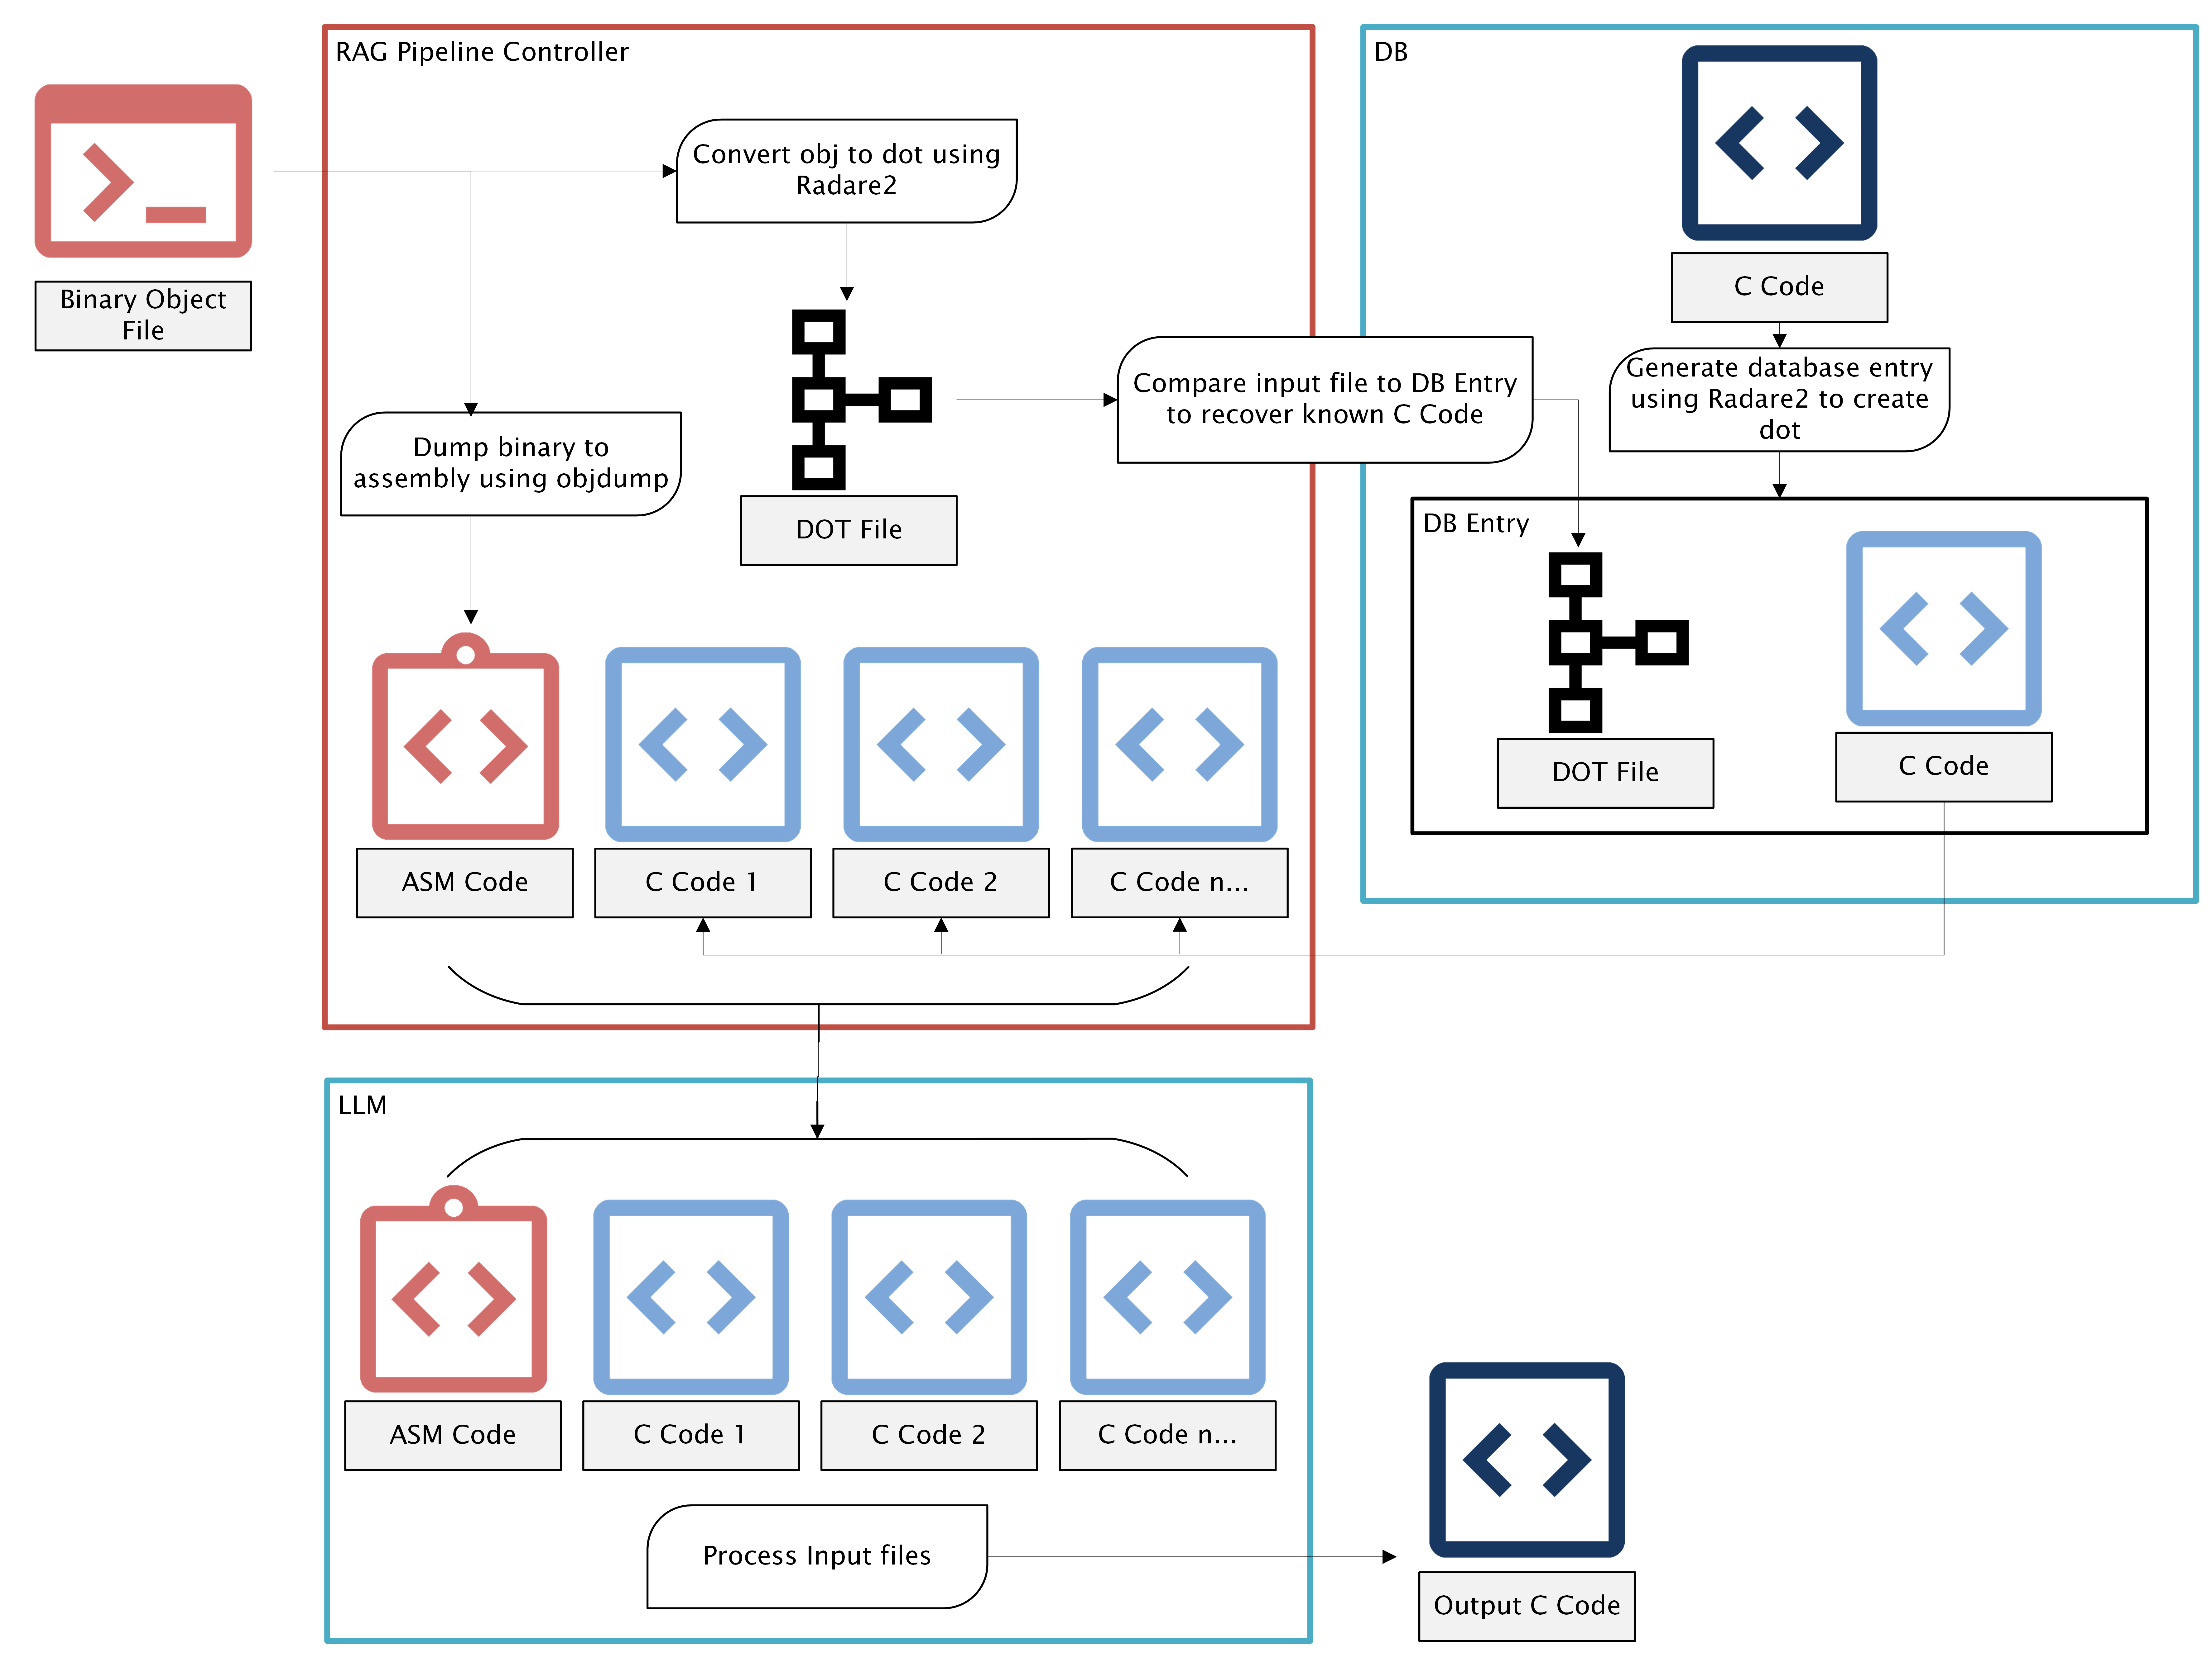
Final Design – GLeNN Pipeline
Comprehensive pipeline to decompile executable programs into C code
Takes in compiled binary code
Generates CFG and relative embeddings directly from input file
Performs a two-pass search on a function database
Retrieves relevant contextual information from database
Queries the generative model with a context rich prompt
Delivers C code file with disassembly
Notes:
"Here’s our final pipeline. We start with compiled object files, extract CFGs using Radare2, and store everything in Neo4j. We then search using both vector and GED-based comparisons and feed the best matches into the LLM. This creates a decompiler that actually understands what it's looking at."
______________
The insights and experiences gained from these preliminary experiments greatly influenced the design and implementation of our final GleNN pipeline. The initial vectorized experiment highlighted the fundamental advantage of contextual embedding retrieval methods and validated the core concept behind RAG. Conversely, the CFG-focused experiment underscored the importance of accurate and direct CFG representations for achieving meaningful comparisons and emphasized the limitations of indirect CFG generation and overly simplistic comparison methods. Consequently, our final pipeline prioritized robust and accurate CFG extraction techniques directly from binaries, coupled with advanced structural retrieval mechanisms to improve accuracy significantly. Our future directions include refining direct CFG generation methods, further enhancing semantic and structural embedding quality, and optimizing the retrieval process through hybrid methodologies. These strategies aim to effectively balance computational efficiency with high accuracy in structural and semantic code analysis.
GleNN is implemented as a modular pipeline that integrates binary analysis, graph-based retrieval, and LLM inference. Its goal is to improve decompilation accuracy by supplementing a language model’s predictions with real-world C code retrieved from a similarity-based graph database. The full process consists of five stages: source compilation and disassembly, CFG generation, structural embedding, retrieval-based filtering, and final LLM-guided decompilation.

Slide 13
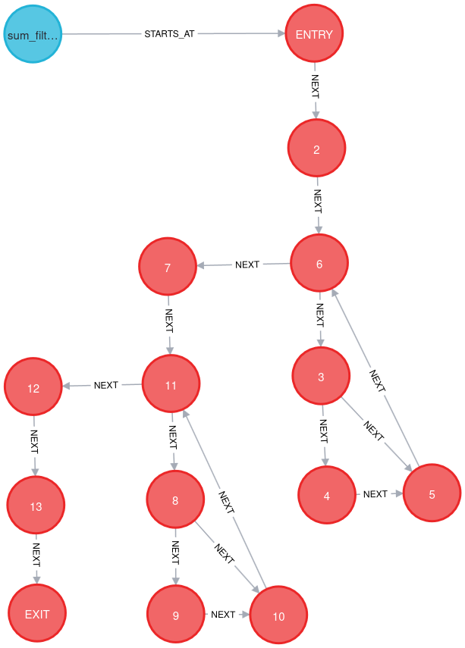
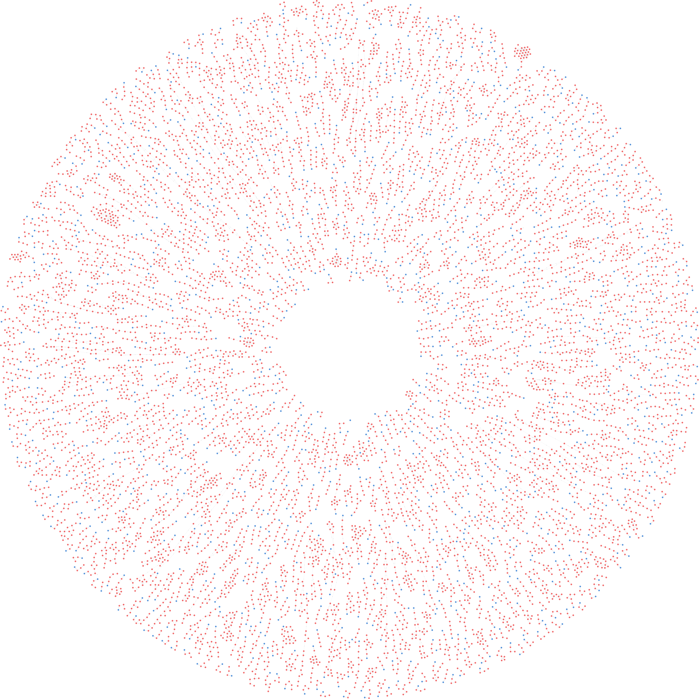
Neo4j Graph Database and Retrieval
25,000 C code functions stored as CFGs
ExeBench Training dataset of C Code snippets
Embeddings and metadata includes blocks, edges, loops, decisions
Notes:
"Our Neo4j graph database is the heart of our retrieval system. Each node is a function, and we track detailed structure information like blocks, edges, loops, and decisions. We also store the original C code, DOT graph, and assembly for reference."
______________
\subsection{Binary Analysis and CFG Generation}
The pipeline begins with a dataset of source-level C code extracted from the ExeBench Train Real Compile split, totaling over 25,000 unique functions. These C files were selected because they compile cleanly and cover a broad range of function types, offering a strong foundation for CFG analysis. Initially, we compiled each C file using GCC with the \texttt{-fdump-tree-cfg-graph} flag to generate its control-flow graph (CFG) representation. Each GCC-generated CFG contains labeled basic blocks, control edges, loop indicators, and decision branches, reflecting the logical structure of the original function. These CFGs were intended to populate our Neo4j database as the reference graph set for later retrieval.
However, as our research progressed and we began developing the retrieval and query side of the pipeline, several issues emerged that challenged this approach. In early iterations, our pipeline attempted to reverse-engineer unknown binaries by having the LLM first generate a C version of the input assembly. We would then compile that generated C code using GCC to produce a new CFG, with the expectation that this CFG could then be compared structurally to those stored in the database.
This strategy introduced significant sources of error. First, the LLM-generated C code frequently included hallucinations, such as extraneous logic blocks, incomplete functions, verbose syntax, or unconventional formatting. These errors led to compiler failures or malformed CFGs, where essential control paths were either missing or split unexpectedly. Even in cases where compilation succeeded, the resulting CFGs often misrepresented the structure of the original function due to semantic deviations introduced by the model.
As we investigated further, a second and more subtle problem became evident: even when C code was valid and compiled cleanly, the GCC-generated CFGs were structurally inconsistent with those derived from Radare2, the tool we were using to extract CFGs from actual binary object files. Specifically, GCC would frequently split return statements into multiple basic blocks, while Radare2 would merge them into a single block. These small but significant structural mismatches led to differences in node and edge counts, which distorted our similarity metrics and reduced the reliability of retrieval.
These issues compelled us to reevaluate our approach. To reduce model-induced error and eliminate tool-specific variance, we made a key architectural change: all control-flow graphs—both for the reference dataset and for input queries—would be generated exclusively using Radare2. Rather than using C code to generate CFGs via GCC, we instead compiled the source code into object files and used Radare2 to extract CFGs directly from these binaries. This ensured that every function, whether part of the training corpus or a test input, underwent identical processing with consistent CFG formatting and semantics.
By standardizing on Radare2 as the sole CFG extraction method, we eliminated a major source of inconsistency and aligned our entire dataset under a unified structural representation. This shift dramatically improved retrieval accuracy and ensured that comparisons using Euclidean distance and graph edit distance reflected genuine logical similarity rather than differences in how CFGs were formed. In effect, our lesson learned—that tool variance can distort structural similarity—directly shaped this methodological refinement and became a cornerstone of our final pipeline design.
\subsection{Graph Database Construction} All reference CFGs are stored in a Neo4j graph database. Neo4j was selected due to its suitability for graph-based similarity matching. Each function node includes embedded structural metrics such as the number of basic blocks, edges, loops, and decisions. These properties allow for fast filtering and pre-selection of candidate functions before deeper graph comparison occurs.
Each function’s control flow is stored using a node-edge format that reflects the CFG. Relationships between basic blocks are marked using \texttt{NEXT} edges, while function-level metadata includes associated C code, assembly, and source file names. This structured representation allows both structural and semantic retrieval to be performed efficiently. This structure was iteratively refined based on feedback from early visualization and query testing, which revealed overly dense or cluttered graphs when edges were overly connected. Cleanup scripts and unique function identifiers were later introduced to ensure integrity and reduce noise. A visual example of this structure can be seen in Fig.~\ref{fig:neo4j-function}, which shows a parsed function with labeled basic blocks and their relationships.

Slide 14
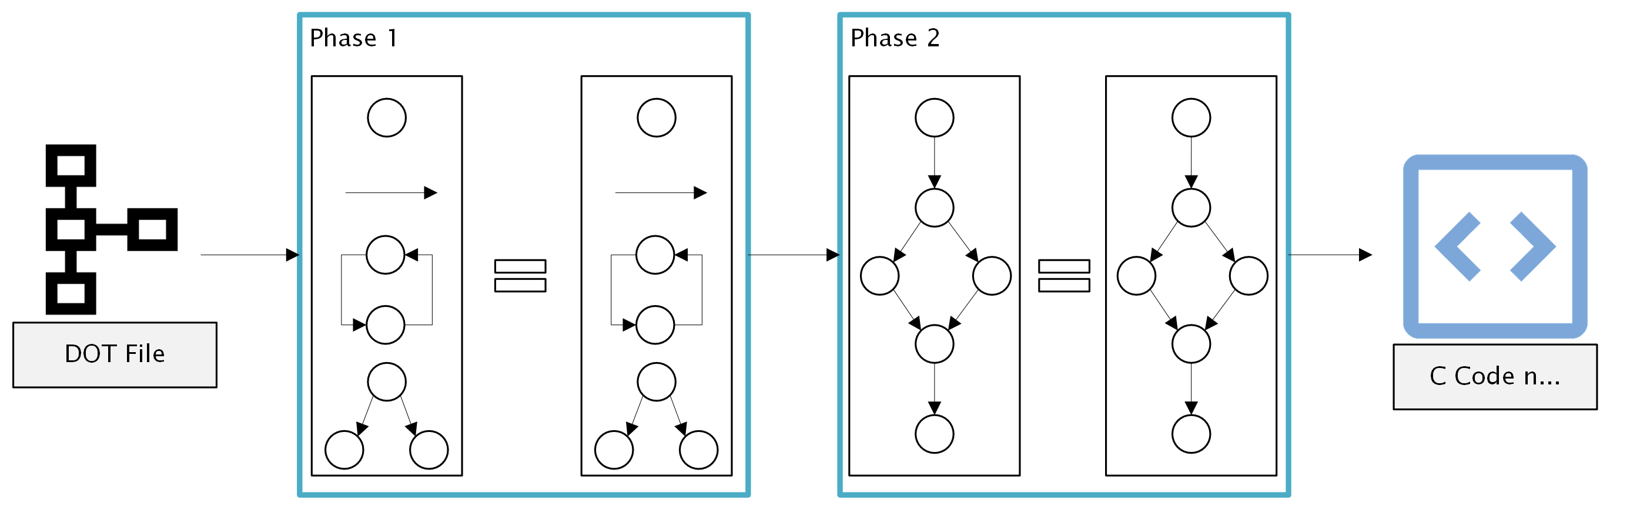
Two-Pass Retrieval
Pass 1: Euclidean distance filtering on vectors
Refines the 25k database entries to only consider structurally similar functions
Pass 2: Graph Edit Distance
Further refines the pass 1 results performing a GED calculation on each entry
This improved retrieval speed without sacrificing accuracy
Notes:
"The first pass quickly narrows down candidates by comparing structure stats. Then, we do a deeper comparison using GED, which checks how many edits are needed to make two graphs match. This combo gives us both speed and accuracy."
______________
\subsection{Two-Pass Retrieval Mechanism} To balance performance and accuracy, GleNN uses a two-pass retrieval method:
\textbf{Pass 1 – Feature-Based Filtering:}
The system computes a Euclidean distance between the input function's structural vector and each function in the Neo4j database. This vector includes block count, edge count, loop count, and decision count. The closest candidates by feature distance are selected for deeper comparison. In order to preserve computations in the second pass, this pass will only return \textit{N} number of results, which is defined when calling the \texttt{GED\_search} function. \textit{N} can be exceeded only when a perfect distance of 0 is identified, in which case all functions with distance 0 are returned and remaining slots are filled as needed.
\textbf{Pass 2 – Graph Edit Distance (GED):}
Using NetworkX, the graph edit distance is calculated between the normalized CFG of the input and each candidate. GED measures how many edits (node additions, deletions, edge changes) are needed to transform one graph into another. The top \textit{N} CFGs with the most similarity are selected based on this score. Again, \textit{N} can be exceeded if multiple candidates have a perfect GED score of 0, ensuring that all structurally identical functions are retained. As illustrated in Fig.~\ref{fig:cfg-comparison}, our system successfully matches input functions to structurally identical entries from the Neo4j database, preserving key CFG features.
This two-pass architecture was shaped by performance bottlenecks observed during testing. Originally, GED was applied across the entire dataset, which proved prohibitively slow. The introduction of Pass 1 allowed us to prune irrelevant candidates early and reduce runtime from hours to minutes in large-scale batch processing. Fig.~\ref{fig:two-pass} summarizes both phases of the retrieval process, contrasting high-level structural filtering in the first pass with detailed graph edit distance calculations in the second.

Slide 15
LLM Decompilation
Uses DeepSeek R1 (Qwen-14B Distill) model.
Prompt includes raw disassembly + similar C code retrieved.
Output constrained via prompt engineering, delimiters, and system instructions.
Results evaluated on compile-ability and re-executability.
Notes:
______________
\subsection{RAG-Enhanced LLM Decompilation} Once similar functions are retrieved, their original C code is extracted and used to construct a prompt for the LLM. GleNN uses the DeepSeek R1 Distill Qwen-14B model to perform the final decompilation. The prompt includes the raw disassembled assembly code and selected reference C functions as structural guides.
To ensure a clean output, the model is instructed to return only the C code. However, early results often included verbose explanations or formatting inconsistencies that broke our post-processing pipeline. This prompted multiple rounds of refinement in how prompts were constructed. We introduced strict system-level instructions, discouraged extra commentary, and used explicit delimiters (e.g., triple backticks) to segment output for reliable parsing.
Each generated file is then evaluated through a two-step verification process: compilation using GCC and dynamic re-execution testing. These validation steps directly measure the utility of the output and have revealed that the presence of RAG context improves re-executability even when the base model remains unchanged.

Slide 16
Results
Models | Re-compliable | Re-executable
 |  | Compiles as Executable | Executes | Does Not Compile
LLM4Decompile | 63.8% | -- | 63.4% | --
LLM Baseline | 81.3% | 63.69% | 86.97% | 36.31%
LLM with RAG | 74.2% | 85.87% | 99.41% | 14.12%
Notes:
"Here are the results. GLeNN beat both LLM4Decompile and DeepSeek baseline. The RAG context made a 12.44% improvement in re-executability. That means the code it produced didn’t just compile—it ran as expected."
______________
Experiments were conducted across three configurations: LLM4Decompile (22B), the DeepSeek baseline model without retrieval, and GleNN’s RAG-enhanced pipeline. Each configuration processed a shared dataset of compiled functions.
To assess performance, outputs were evaluated using two metrics:
\begin{itemize}
\item \textbf{Compile-ability:} Whether the generated code compiled successfully.
\item \textbf{Re-executability:} Whether the resulting binaries executed without runtime errors.
\end{itemize}
These results demonstrate that the DeepSeek baseline model alone substantially outperformed LLM4Decompile in compile-ability. However, when RAG was introduced, GleNN’s pipeline further improved compile success and re-execution performance.
To control for the non-determinism of LLMs, each configuration was run across three iterations. Resulting C code files were collected, compiled, and executed using a standardized batch validation script. Any compilation errors or runtime faults were logged for analysis.
Notably, the addition of RAG contributed a 12.44\% improvement in re-executability over the LLM baseline, indicating that contextual retrieval helps reduce hallucinated logic and incorrect structure. The compile-ability gain over LLM4Decompile and over the baseline also supports the conclusion that structural alignment improves syntactic precision.

Slide 17
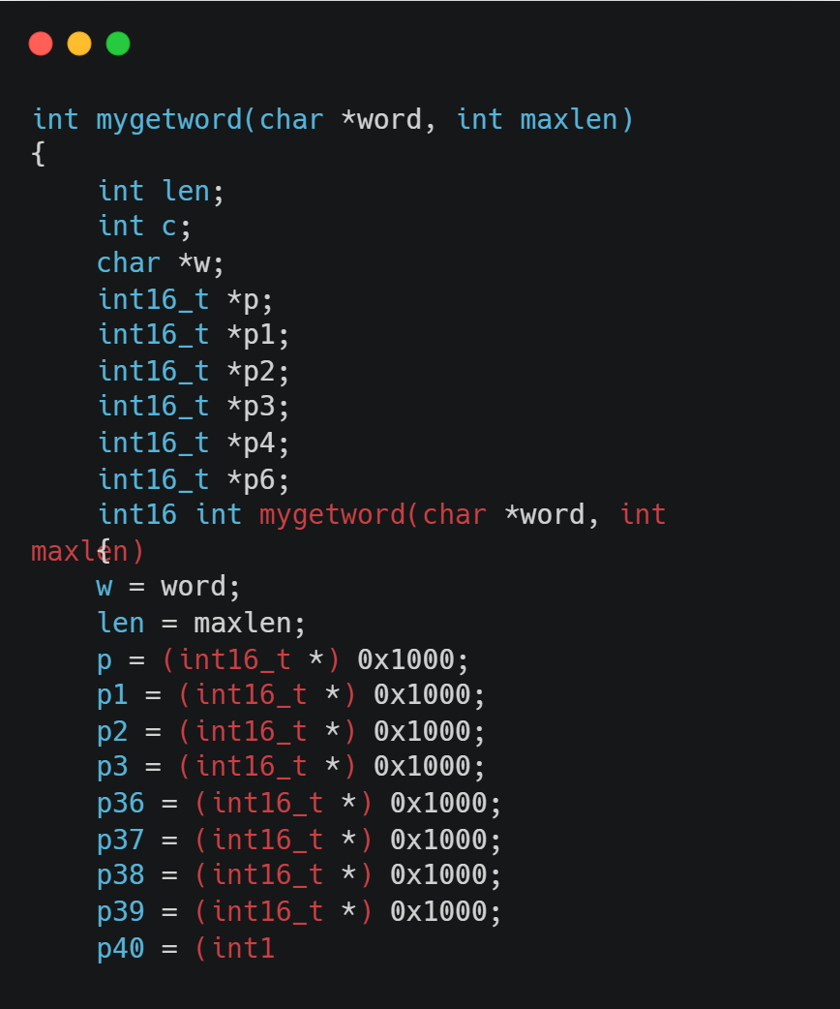
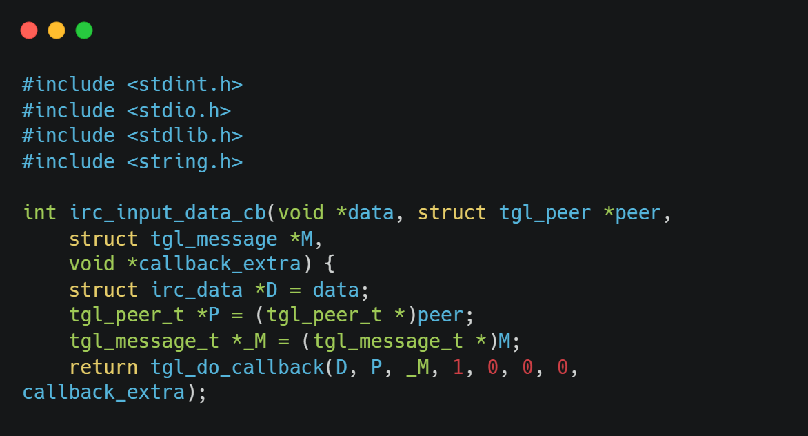
Common Errors With LLM4Decompile
Hallucinated includes not present in original code
Possibly related to training data for the LLM
Infinitely repeated lines
Repeated lines until some character limit is reached
Re-executable tests kills processes very quickly.
Possible missed errors later in code

Slide 18
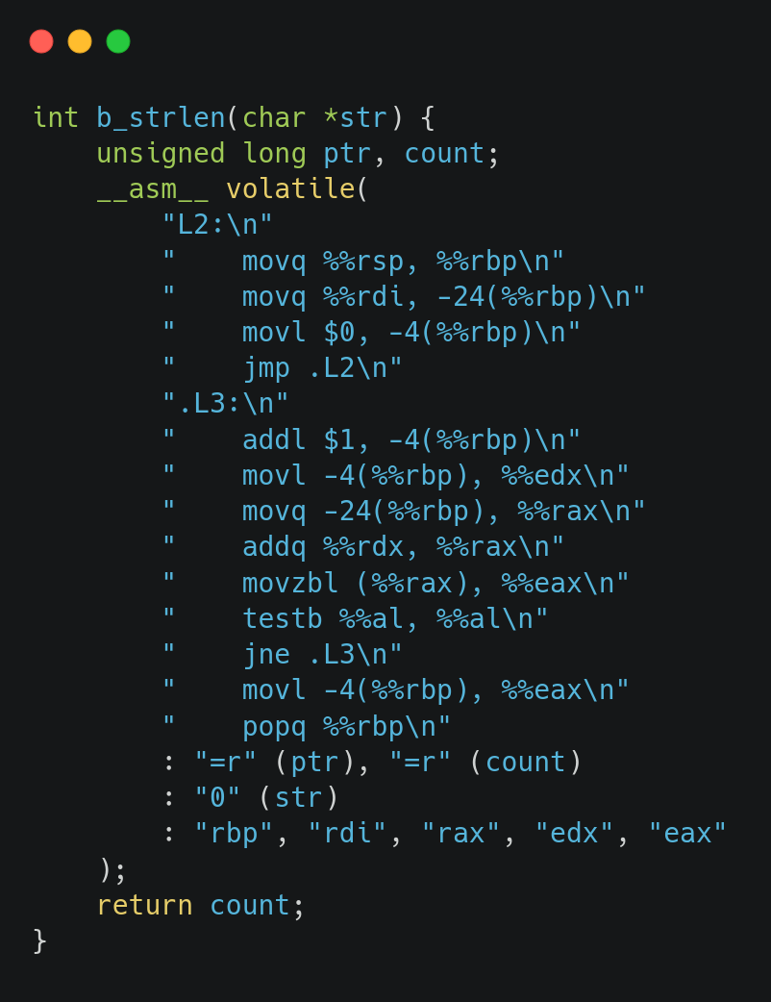
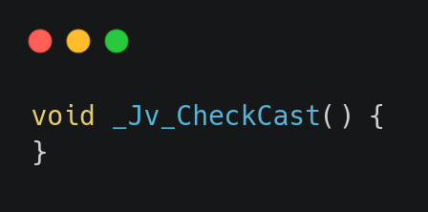
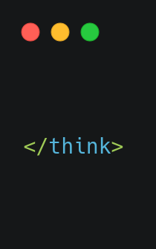
Common Errors With GLeNN
Conversation within code delimiter
A result of programmatic testing
Inline Assembly
Functions with no content
Re-executable tests kills processes very quickly.
Possible missed errors later in code

Slide 19
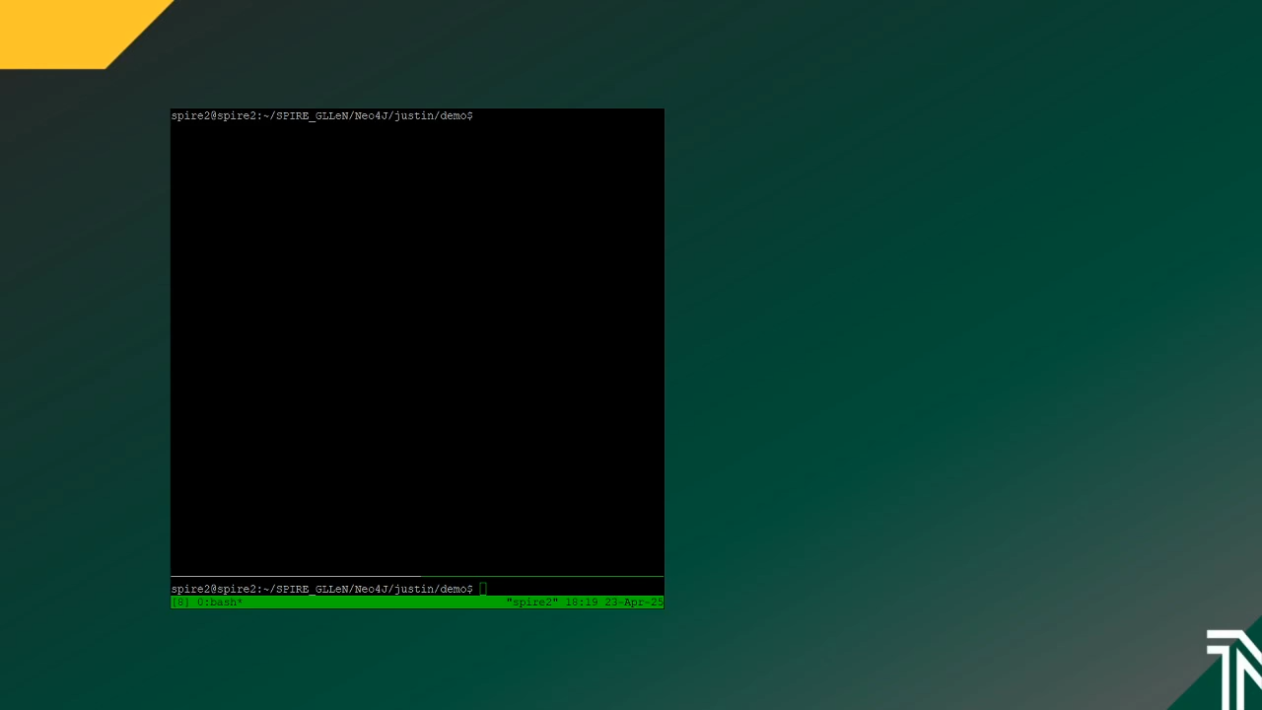
Case Study – Demo
Notes:
Good morning or afternoon, this video is going to be a walkthrough of the process and performance of the GLENN pipeline. The GLENN pipeline is a static decompilation tool that is capable of taking input exectuable binary files and returning human readable high level C code.
This demo is going to follow along using this example C code.
[Display count_alpha_digit.c code]
This code is fairly simple but there are 3 key areas that I want to highlight and focus on.
The first is the use of two for loops to iterate over a passed in string. These loops are bound by another argument, the length, to control the stop position dynamically.
The second is the decision structure within the program. The first for loop checks if the current character is a capital 'A' and the second for loop checks if the character is a '0'.
The third key element is the overall structure and design of the program. This includes the two specific arguments, the local variable, and the return statement of the program. As we developed our pipeline the ability to accurately recreate the input functions logic and structure was the metric of performance.
[Close C code]
[Display terminal with directory structure][TMUX Terminal]
On our experiment environment ive prepared a couple files.
The first is the C code that we just reviewed, count_alpha_digit
The second file, is the compiled binary program count_alpha_digit.o
And then two directories. The first one, temp, is used to store the inner process functions and files the pipeline creates. These are non-essential functions and can be cleared after running.
The second directory will store our output code separately to ovoid overwriting files and to save the result of the pipeline.
[clear terminal]
I am going to initiate the pipeline and pass in the file path to the object file. Currently, the pipeline operates as a terminal utility with directory structures and filepaths stored locally or used as inputs.
The pipeline takes a couple minutes to complete, so as it is processing I will continue to break down the steps that it performs.
[Split terminal vertically][Continue on the right side of terminal]
[Display files in directory to show files in temp]
The first process that it performs is generating a CFG for the input function. This is performed using radare2 and happens directly to the input file. This CFG will be passed into the database to perform our similarity search.
[Display input CFG picture]
Here we can see the CFG of the input function as well as a couple of the key elements we identified before.
The CFG clearly represents the two loop structures of the input function and we can even recognize the decisions and if statements within the program. [Close CFG image and show files again]
The second process that happens when the pipeline starts is recovering the assembly code from the object file. To do this, objdump is used to generate the assembly code using the command line. In our code, we use the os library to execute the command line program.
The assembly code of the input function will be whats passed into the model for final decompilation.
[show the left terminals results of similarity search]
By now, the pipeline should have executed all of these steps and be in the process of performing the similarity search among the Neo4j database containing 25 thousand CFG's and related information representing a unique dataset of c functions from ExeBench.
This similarity search is done in two passes.
The first pass narrows down the scope of the search to only include functions that contain the same number of nodes, edges, loops and decisions that the input function did. This information is stored in the database as a series of custom embeddings. During this initial phase of the search, these vectors are generated by the pipeline to trim the scale of the database down to a few relevant functions to reduce the computation time required for the second phase.
This second phase, performs a graph edit distance that calculates a score based on the amount of transformations required to make the input functions CFG match the database CFG. These scores are a lower is better system so the goal of this phase is to recover as many functions with a GED value of 0. The process has some further time saving functionality to halt calculations if they are going to result in a worse GED than the current lowest in order to save as much time as possible. The GED calculation is highly accurate but also very slow.
[Hopefully GED has finished] [Display sum_filtered_rows and count_alpha_digit comparison photos]
Choosing one of the functions identified in the search, we can take a manually look at the graphs to see what the pipeline performed. Here we can see the input function on the left, and the returned function on the right. By comparing these two CFGs we can identify the same looping structure and decision structure within each program, which can be seen here
As a result of the search, the closest matching functions are returned and the original C code used to create these graphs is retrieved. These functions are going to be the additional context used by our model to better understand the unknown function. By taking cues and information from the provided C functions, the model is better able to reconstruct the logic of the input function in the C language.
[Show example model input]
Here is an example of the input prompt given to the model. In this prompt we can recognize the retrieved functions provided as additional context, as well as the assembly code for the input function. The prompt to the model directs it to decompile the assembly code, using the provided c code as a reference for structure. After the model processes this input, it parses the return of the model and writes it to a file.
[Display count_alpha_digit_out.c]
Here we can look at the resulting C code output of the pipeline. Within this program we can recognize the original logic of the loop structure of two for loops as well as the correct decision structure checking for the character capital 'A' and for the number '0'
A slight difference between the input function and the output of the pipeline is the arguments in the function definition. The input function passes in an integer length that controls how much of the string the program iterates over.
In our returned function, this is calculated based of the string length of the input function. This does not lose the functionality of the input function but in some situations you could pass a value different than the length of the string to the input function and that is a difference between the input and our pipelines output code.
[Display baseline_count_alpha_digit_out.c]
For context on the impact of the RAG element of this pipeline, here is the returned result of the model without the RAG layer. In this code we can recognize some more differences.
The most notable difference is the change in logical decision being performed. The output function here counts ALL alphanumeric characters within the word instead of just 'A' and '0'. Additionally, this program now uses a while loop as the control loop instead of a for loop. The output of this program would not match the input functions.

Slide 20
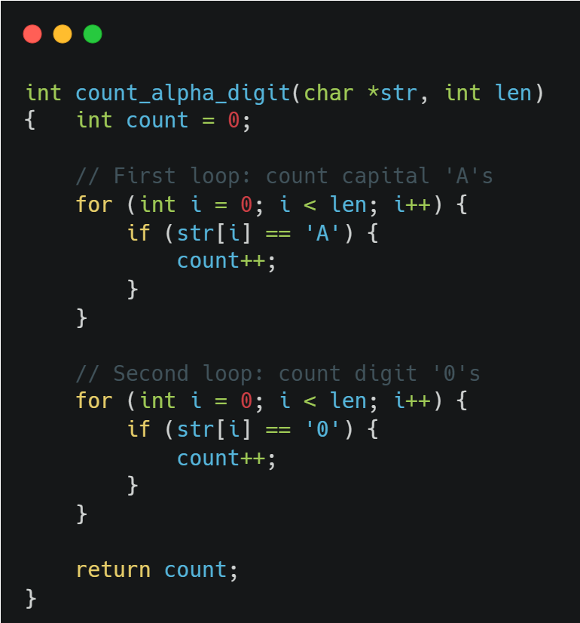
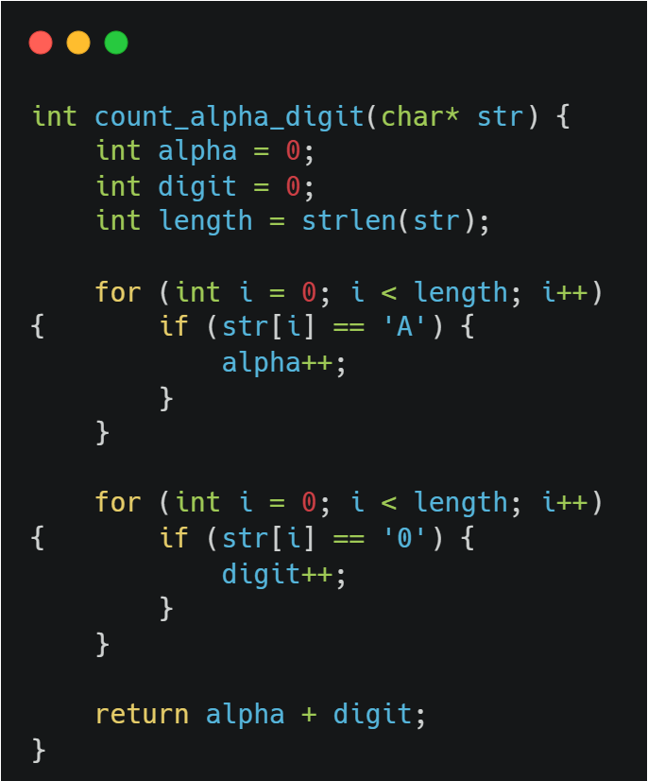
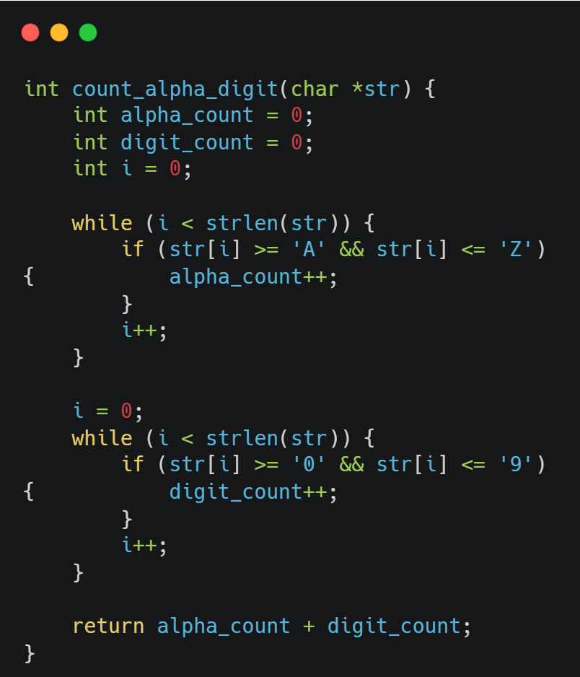
Case Study – count_alpha_digit
Expected return
Pipeline returned
Baseline returned

Slide 21
Case Study – count_alpha_digit
Original input function
Function scans a string for 'A' and '0'
Two arguments:
Input string to iterate over
Integer length to control how much of the string to iterate
Notes:
"In this example, the function counts the number of 'A' and '0' characters. The baseline model used while loops and overgeneralized logic. GLeNN, however, used for-loops and exact matches, recovering the original structure and behavior."

Slide 22
Case Study – count_alpha_digit
GLeNN Pipeline Output:
Key Points:
Correct loop structure
Correct decision structure
Alternate logic for arguments
Loses functionality to control length of iterator

Slide 23
Case Study – count_alpha_digit
Baseline Returned
Key Points:
Utilized while loops to retain same logic structure instead of for loops
Incorrect decision structure counts ALL alphanumeric characters

Slide 24
Achievements
35 pp increase over LLM4Decompile
Two-pass Neo4j retrieval (vector + GED) → cuts down on LLM hallucinations
Proved that RAG enabled LLMs greatly enhance static decompilation precision & completeness
Fully open source and available on GitHub

Slide 25


Discussion and Future Work
Future:
Extend to full-program decompilation.
Improve LLM tuning and CFG embeddings.
Notes:
"We’re proud of what GLeNN can do, but there are limitations. We’re working on scaling up to whole-program analysis and reducing GED computation time. We also want to support more compiled languages beyond C."
"GLeNN is useful to anyone working with unknown binaries. Analysts, security researchers, and students can all benefit. It can help triage malware, analyze embedded firmware, and even teach reverse engineering more effectively."
______________
\section{Discussion and Conclusion}
The results of our experiments affirm the potential of Retrieval-Augmented Generation (RAG) in improving the performance of large language models in static reverse engineering. By leveraging graph-based similarity search through control-flow graphs (CFGs), GleNN provides semantically relevant reference code that guides the LLM toward producing more accurate and executable decompilations.
The RAG-enhanced model demonstrated a 12.44\% improvement in re-executability over the baseline model. Of the functions that successfully compiled, 99.41\% were re-executable, highlighting that RAG not only improves semantic coherence but also reduces hallucinated or invalid logic. This outcome surpasses the performance of both the standalone DeepSeek baseline and LLM4Decompile, which previously represented the state of the art. These findings suggest that integrating graph-based structural retrieval can meaningfully enhance reliability in LLM-assisted decompilation.
One of the primary limitations of our current system is that it operates at the function level. Each test case involves the decompilation of a single function, which does not capture the complexities of interprocedural relationships, shared memory, or dynamic symbol resolution. Expanding the GleNN pipeline to operate on full programs would allow us to test whether context-aware retrieval and prompt construction can scale across larger, real-world software targets.
Another consideration is performance. While the two-pass retrieval strategy significantly improves accuracy, it introduces computational overhead—particularly during the graph edit distance (GED) calculations. Optimizing or approximating GED, introducing candidate caching, or parallelizing retrieval operations are key future directions to improve real-time usability.
From a modeling perspective, while the DeepSeek R1 model performed well in generating clean C code, it is not specifically tuned for reverse engineering. As a result, outputs occasionally include redundant syntax, missed type declarations, or extraneous logic structures. Fine-tuning on assembly-to-C datasets or incorporating structure-aware decoding constraints could further reduce these inconsistencies.
A critical bottleneck in the current pipeline is the model’s sensitivity to prompt structure. Despite using fixed input templates, the model frequently produces inconsistent outputs—including verbose commentary, format violations, or syntax that does not compile. These inconsistencies break downstream parsing logic and hinder automated CFG generation. Improving prompt engineering practices—such as refining system instructions, enforcing stricter response formats, or using delimiters for code extraction—may significantly improve output stability and overall pipeline reliability.
Looking beyond C, GleNN’s architecture is language-agnostic and could be extended to support other compiled languages such as C++, Rust, or Go. With appropriate training data and CFG compatibility, the pipeline could be generalized to help reverse engineer binaries written in various languages or compiled for different architectures.
This approach also holds promise in real-world scenarios. Malware analysts could use GleNN as a triage tool to quickly produce reviewable C code from unknown binaries. Embedded firmware analysts, vulnerability researchers, or incident response teams might benefit from integrating GleNN into their toolchains to speed up static inspection workflows.
In conclusion, GleNN demonstrates the effectiveness of combining graph-driven retrieval with large language models to improve the reliability of automated decompilation. With continued research in model specialization, retrieval accuracy, and scalability, GleNN offers a promising foundation for next-generation reverse engineering tools.

Slide 26
References
H. Tan, Q. Luo, J. Li, and Y. Zhang, “LLM4Decompile: Decompiling Binary Code with Large Language Models,” arXiv preprint, arXiv:2403.05286, 2024.
DeepSeek AI, “DeepSeek Coder,” [Online]. Available: https://huggingface.co/deepseek-ai
J. Arib, “ExeBench: A Benchmark for Binary Decompilation,” Hugging Face Datasets, 2024.
Neo4j, Inc., “Neo4j Graph Database Platform,” [Online]. Available: https://neo4j.com
Radare2 Project, “Reverse Engineering Framework,” [Online]. Available: https://rada.re/n/
National Security Agency, “Ghidra Software Reverse Engineering Framework,” [Online]. Available: https://ghidra-sre.org/
GCC Team, “The GNU Compiler Collection,” Free Software Foundation, [Online]. Available: https://gcc.gnu.org
Hugging Face, “Transformers: State-of-the-art Machine Learning for PyTorch, TensorFlow, and JAX,” [Online]. Available: https://huggingface.co/docs/transformers
Z. Feng, D. Guo, D. Tang, N. Duan, X. Feng, M. Gong, L. Shou, B. Qin, T. Liu, D. Jiang, and M. Zhou, “CodeBERT: A Pre-Trained Model for Programming and Natural Languages,” arXiv preprint, arXiv:2002.08155, 2020. [Online]. Available: https://huggingface.co/microsoft/codebert-base
Facebook AI Research, “FAISS: A Library for Efficient Similarity Search,” [Online]. Available: https://github.com/facebookresearch/faiss

Slide 27
Q & A
Thank you

